Slide 1
Designing a MEAN stack architecture

Slide 2
The common way to architect MEAN stack application is to have Representational State Transfer Protocol.
REST - REpresentational State Transfer
API – Application Programming Interface.
REST API - stateless interface for applications.

Slide 3
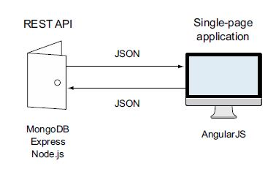

Slide 4
Planning the Real Application
Loc8r
Loc8r will list nearby places with WiFi where people can go and get some work done. It will also display facilities, opening times, a rating, and a location map for each place. Visitors will be able to submit ratings and reviews.
1st step – Think about the screens that we will need in our application.

Slide 5
Planning the screens
A screen that lists nearby places
A screen that shows details about an individual place
A screen for adding a review about a place
A screen for “about us” information

Slide 6
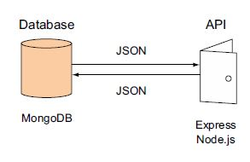
Architecting the application Starting with the API

Slide 7
Application Architecture Options
A Node.js and Express application
A Node.js and Express application with AngularJS additions for interactivity
An AngularJS SPA

Slide 8
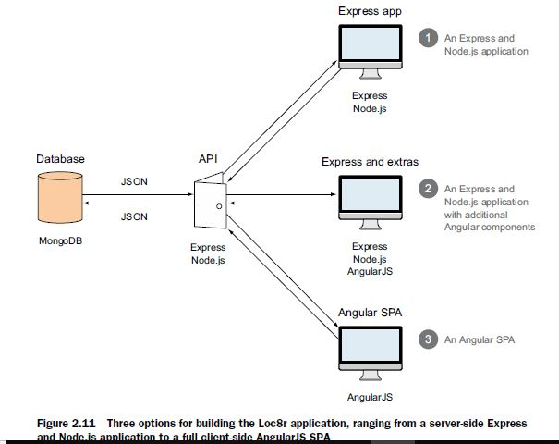

Slide 9
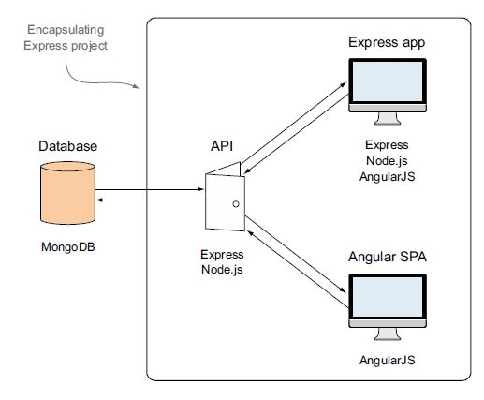
Wrapping in Express

Slide 10
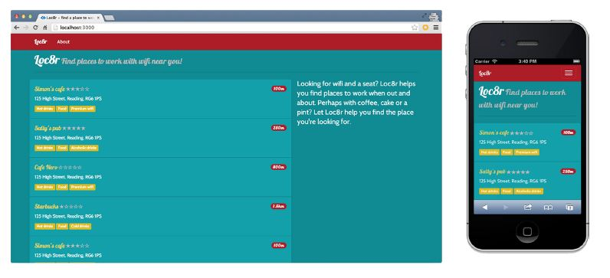
END product

Slide 11
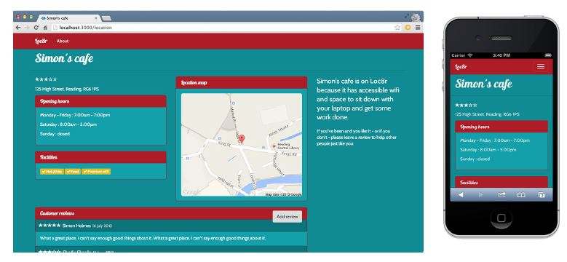

Slide 12
Breaking the development into stages
Build an application on the MEAN stack
Learn about the different layers of the stack as we go

Slide 13
Rapid prototype development stages
STAGE 1: BUILD A STATIC SITE
STAGE 2: DESIGN THE DATA MODEL AND CREATE THE DATABASE
STAGE 3: BUILD OUR DATA API
STAGE 4: HOOK THE DATABASE INTO THE APPLICATION
STAGE 5: AUGMENT THE APPLICATION

Slide 14
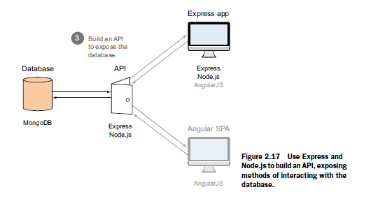

Slide 15
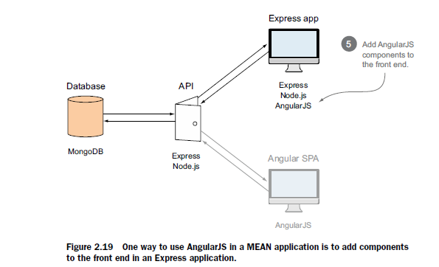

Slide 16
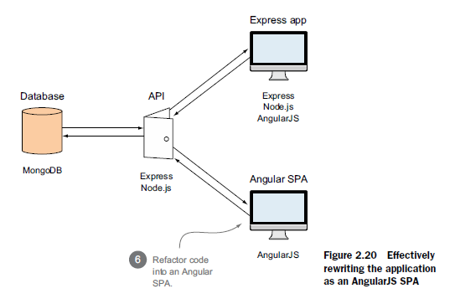

Slide 17
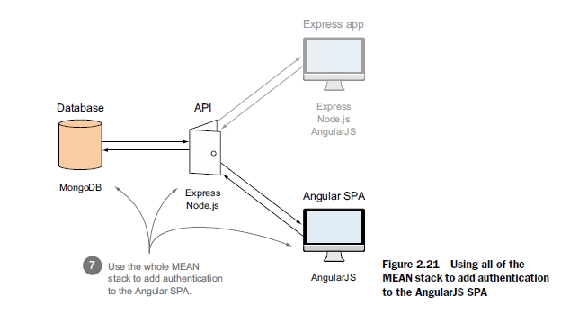

Slide 18
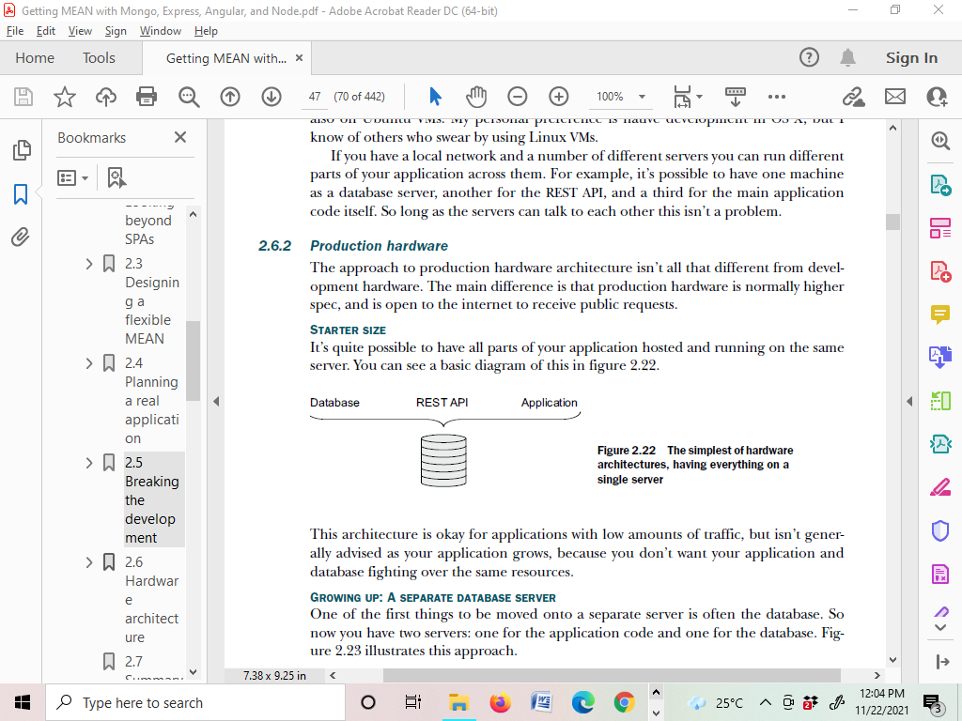
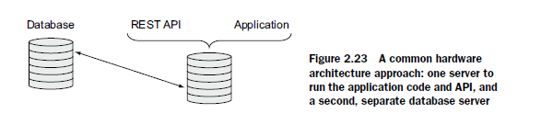

STARTER SIZE
GROWING UP: A SEPARATE DATABASE SERVER
GOING FOR SCALE

Slide 19
